Slide 1
COACHING-INNOVATIVE APPROACH FOR BETTER INTEGRATION OF REFUGEES
Gabriela Ionescu
Trainer
Pro Refugiu Association
2015, February 24

Slide 2
Coaching session 1. Create a safe and positive environment 2. Be empathetic, encouraging, understanding, non-judgmental 3. Ask simple and open questions 4. Listen to the coachee, do not rush him, do not attempt to control the direction or content of the conversation. 5. Remember that you are the coach so don’t share and try to solve your own problems in the session 6. Constantly summarize information and elicit self-motivational statements. 7. Give supportive feedback based on fact or behavior

Slide 4
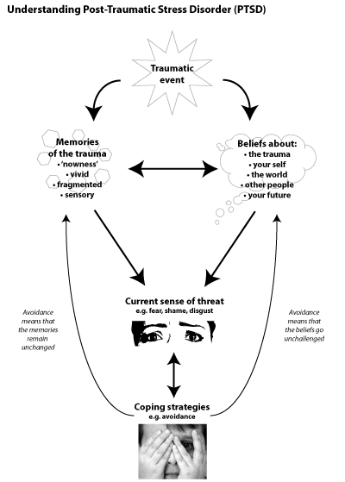

Slide 5
Trauma recovery coaching Trauma Recovery Coaching provides the extra support and guidance one needs to face and overcome the seemingly impossible challenges of life imposed by harrowing experiences at a mental, emotional and even physical level. Recovery coaching is unlike most therapy because coaches do not address the past, do not work to heal trauma, and there is little emphasis on feelings. The recovery coach focuses on helping refugees apply their newly acquired recovery skills in their living environment and to help them resolve any issues or problems that can impact their recovery, such as being unemployed, living in an unstable housing situation, or in need of medical care, lacking social support. The purpose of the recovery plan is to highlight and organize a person’s goals, strengths and capacities and to determine what barriers need to be removed or problems resolved to help people achieve their goals.

Slide 6
Thank you!

